Slide 1

Lecture – 12/1/2016
CSCI 36300 – Software Design

Slide 2
Assignment #5 – Phase I
Due:
Tonight @ 11:59 PM
What you need to submit:
Shared Library Tutorial
Array Shared Library (Assignment #1)
Checklist:
Repository Named Correctly + Collaborators
MPC File(s)
Array Files (Source/Header/etc.)
Driver File
README File
Necessary to tell us the path for the shared library
Valgrind Report
No Memory Leaks Present

Slide 3
Quiz #16

Slide 4
Software Anti-Patterns

Slide 5
Software Anti-Patterns
This semester we have talked about all of these software design patterns…
When to use them…
How to use them…
Why to use them…
We have also outlined why, if not used properly and with good judgement, these patterns can also be dangerous.

Slide 6
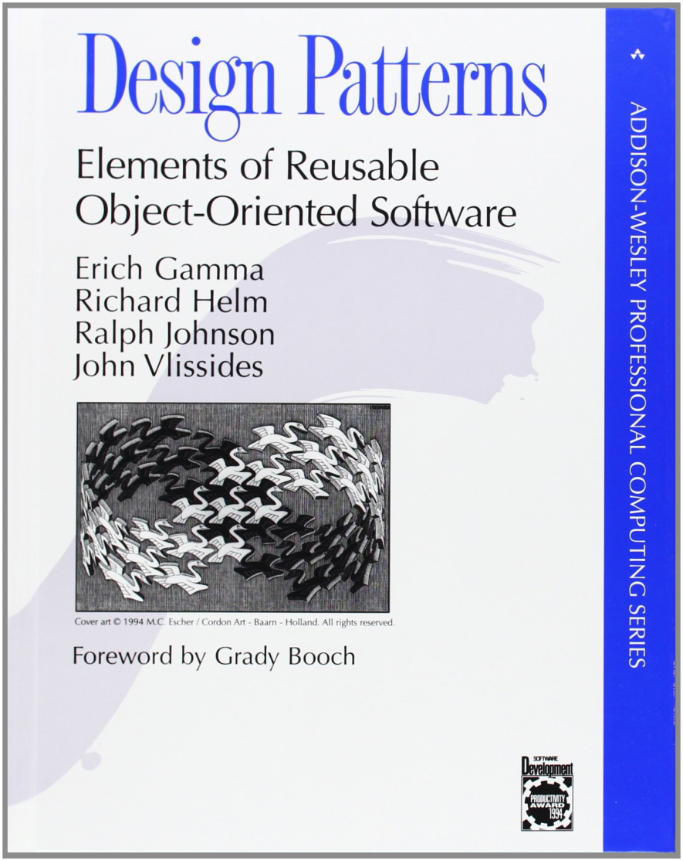
Software Anti-Patterns
What is a software anti-pattern?
“A common response to a recurring problem that is usually ineffective and risks being highly counterproductive.” – Wikipedia
Andrew Koenig
1995

Slide 7
Software Anti-Patterns
How do we formally define what an anti-pattern is in software?
How do we distinguish it from just simply a bad habit or bad programming style?
Two Elements:
A commonly used process, structure or pattern of action that despite initially appearing to be an appropriate and effective response to a problem, typically has more bad consequences than good ones.
Another solution exists that is documented, repeatable and proven to be effective.

Slide 8
Software Anti-Patterns
Are anti-patterns just strictly a software or OO-based problem?
No, we can find examples of anti-patterns in many different domains.
Engineering
Project Management
Organizational Management
Etc.
Any documented solution can serve as the basis for evaluation and effectiveness.

Slide 9
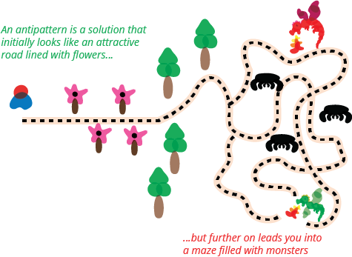
Software Anti-Patterns
Image By: Martin Fowler

Slide 10
Software Anti-Patterns
“An anti-pattern is just like a pattern, except that instead of a solution it gives something that looks superficially like a solution but isn't one.” – Andrew Koenig
Distinguishing Feature:
It looks good so it must be a good and practical solution.
Beware of the dangers that lie beyond…

Slide 11
Software Anti-Patterns
Software Design Patterns:
We often said that there were Consequences (negative) for our design patterns.
How do we ensure that we are using the pattern for its intended purpose?
How do we ensure that we are implementing the pattern properly?

Slide 12
Software Anti-Patterns
Design Patterns:
Describe, established and documented, desirable behavior.
Design Anti-Patterns:
Describe, established and documented, undesirable behavior.
How to tell the difference in practice?
Code Smell…

Slide 13
Software Anti-Patterns
What are the types of Software Anti-Patterns?
We are going to focus on the development type of anti-patterns due to time.
Software Development Anti-Patterns
Software Architecture Anti-Patterns
Software Project Management Anti-Patterns

Slide 14
Software Anti-Patterns
We as developers tend to stray away from what is “planned” and just go towards the light of getting things “done.”
What happens when we take this route?
Code Smell
Potential Side Effects?
Design Patterns
Usage?

Slide 15
Software Anti-Patterns
What can we do to help alleviate these problems associated with anti-patterns?
Refactoring
What is refactoring?
We will cover this more in the next lecture.
At its core, refactoring is a way to improve the code while still preserving its semantics.

Slide 16
Software Anti-Patterns
Continuous Obsolescence
Ambiguous Viewpoint
Functional Decomposition
Boat Anchor
Spaghetti Code
Walking through a Minefield
Cut-and-Paste Programming
Mushroom Management

Slide 17
Continuous Obsolescence
It “seems” like a new version of Java is released every few months.
When a new version is released all of the tricks and tips learned and just discovered are already obsolete by virtual of the new versions “improvements.”
This is often by design…
If we “force” a newer version on you we can make more money.

Slide 18
Continuous Obsolescence
How can we prevent this from happening?
We can’t!
What can we do then?
Standards
We can design our software to revolve around stable components.
How can we build stable components?
Good design principles!

Slide 19
Ambiguous Viewpoint
One of the challenges with designing good software systems is the mixing of implementation, model, and user interface details.
Separation of Concerns
How do we keep similar components together while preventing unnecessary “accesses” that cause confusion – or worse.

Slide 20
Ambiguous Viewpoint
Three Fundamental Viewpoints:
Business Viewpoint
Specification Viewpoint,
Implementation Viewpoint
By breaking these OO Analysis and Design related tasks via these three viewpoints each can be properly expressed and dealt with in turn.

Slide 21
Ambiguous Viewpoint
The business viewpoint defines the user's model of the information and processes.
The specification viewpoint focuses on software interfaces.
The implementation viewpoint defines the internal details of the objects.

Slide 22
Ambiguous Viewpoint
Example:
Let’s look at how we would go about designing a telephone system:
Telephone User
Cares about the ease of making calls and receiving itemized bills.
Telephone Operator
Cares about connecting users to required numbers.
Telephone Accounting
Cares about the formulae for billing and records of all calls made by users.

Slide 23
Functional Decomposition
This anti-pattern has historical context to the time before the OO programming paradigm.
Everything was considered a function or subroutine and ignored a class hierarchy and composition.
While this is often seen in “experienced” programmers it is not always the case.
Know how/when/why to create classes in OO design.

Slide 24
Functional Decomposition
Common Occurrences:
“Classes” that have names that resemble functions.
“Classes” with a single purpose – such as a the behavior commonly found in a single function.
No use of polymorphism or inheritance.
This includes any sort of interaction between different components.
No clear documentation – design documents are either absent or impossible to discern due to the lack of clear hierarchy.

Slide 25
Functional Decomposition
How can you alleviate this problem?
Or is it too far gone to salvage?
Case-by-case basis
Often times you can refactor by creating a coordinate class that helps facilitate the interaction between the various “classes” in the system.
Additional work can be done to convert small components into better design choices through bottom-up refactoring.

Slide 26
Boat Anchor
A piece of software that serves no useful purpose on the current project.
This can come in many different shapes and sizes.
Often acquired through acquisition – but not always.
Can be a by-product of a failed release or a prototype system.

Slide 27
Boat Anchor
Old Adage:
Try before you buy.
Examine the software components and only use those that are essential for the completion of your project.
Similar to the “using namespace std”
Why should we pollute our code when we don’t have to – there has to be a better way, right?

Slide 28
Spaghetti Code
Most famous anti-pattern!
The most common saying:
“It is easier to just rewrite all of this code than try to understand what it is doing.”
This anti-pattern frequently shows up with unexperienced programmers that tend to “hack” their way through code.

Slide 29
Spaghetti Code
Appears as a program or system that contains very little software structure.
The software may include a small number of objects that contain methods with very large implementations that invoke a single, multistage process flow.
It becomes very hard to determine which branch or path we are in and how we arrived at the given location.
GOTO Statements

Slide 30
Spaghetti Code
Methods are very process-oriented.
The flow of execution is dictated by object implementation, not by the clients of the objects.
Minimal relationships exist between objects.
Many object methods have no parameters, and utilize class or global variables for processing.

Slide 31
Spaghetti Code
Code is difficult to reuse.
Benefits of object orientation are lost; inheritance is not used to extend the system; polymorphism is not used.
Extensions are difficult to implement due to the lack of planning.
Software quickly reaches a point of diminishing returns; the effort involved in maintaining an existing code base is greater than the cost of developing a new solution from the ground up.

Slide 32
Spaghetti Code
This is a frequent problem demonstrated by people new to object-oriented development.
Attempt to map system requirements directly to functions, using objects as a place to group related functions.
Each function contains an entire process flow that completely implements a particular task.
Solutions?

